Slide 1
Artificial Lattice
Jan 24, 2019

Slide 2
Today’s discussion
Steven Louie paper on graphene nanoribbons
Analytical expression for Z2
Junction states at the interface between GNRs of two different width
Changing topological class by doping
Possible ways to compute “proxy” for topological invariant
Calculation of Zak phase using finite difference
Calculation of Z2 using Hybrid Wannier Charge Centers (implemented in Z2pack)

Slide 3
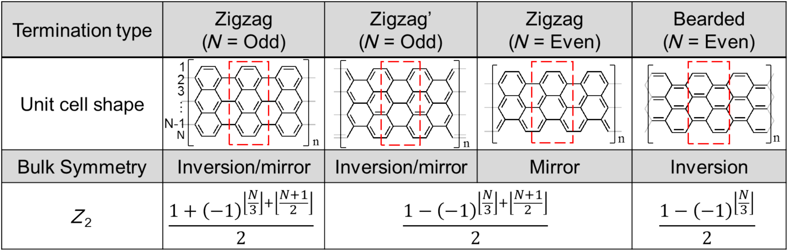
Topological phases in graphene nanoribbon (GNR)
GNR with different width, edge and end termination belong to different electronic topological classes
Topological phases of GNR is characterized by Z2 invariant ( Z2 = 0 or 1)
Explicit formula for Z2 invariant derived analytically by solving Tight Binding Hamiltonian for graphene
Tiang Cao, PRL, 2017

Slide 4
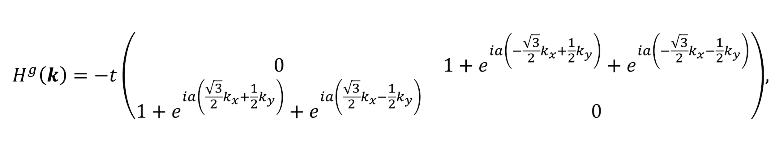
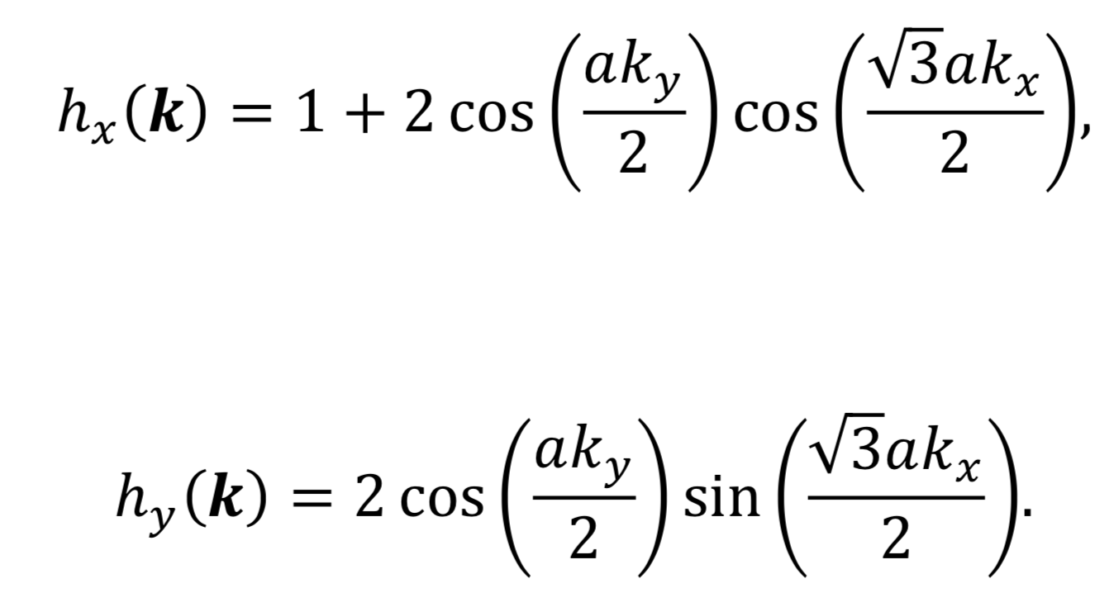
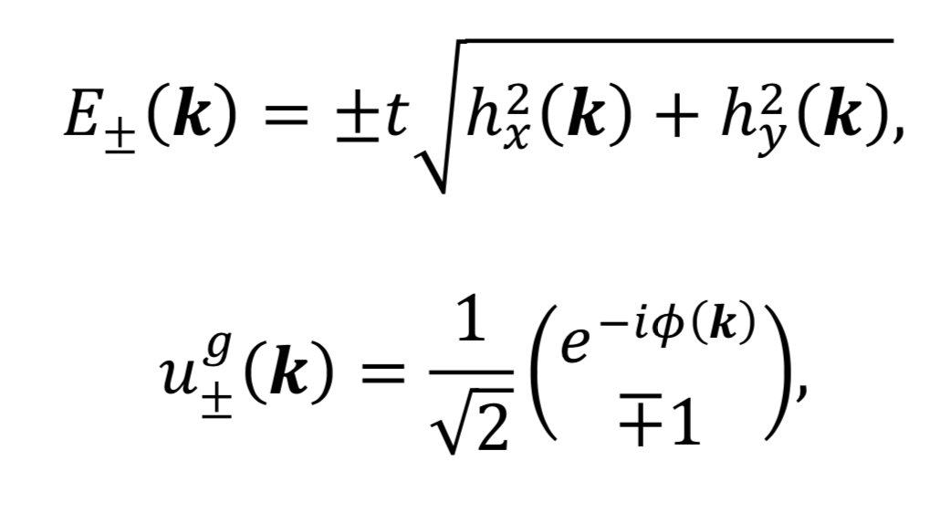
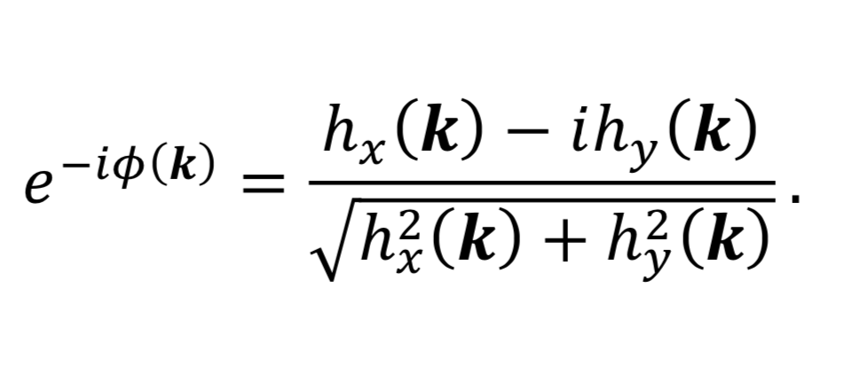
Solving for the eigenvalues and eigenvectors

Slide 5
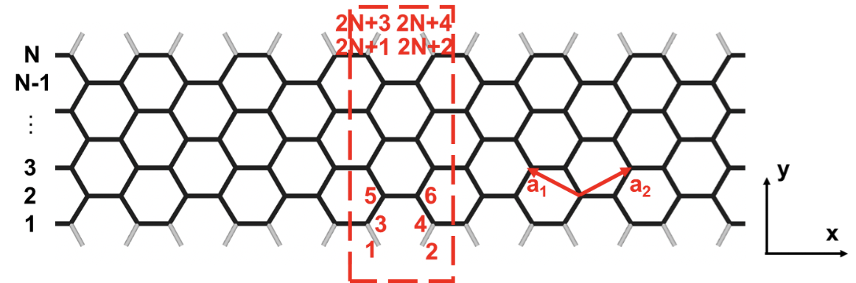
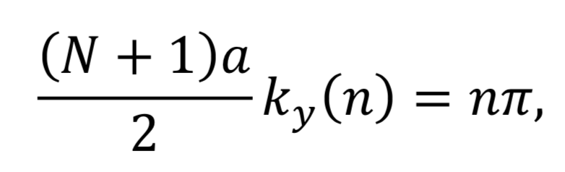
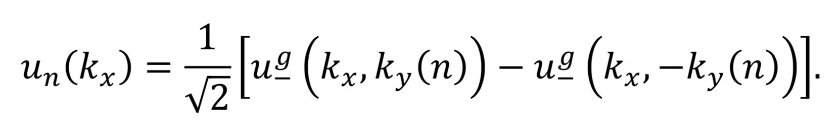
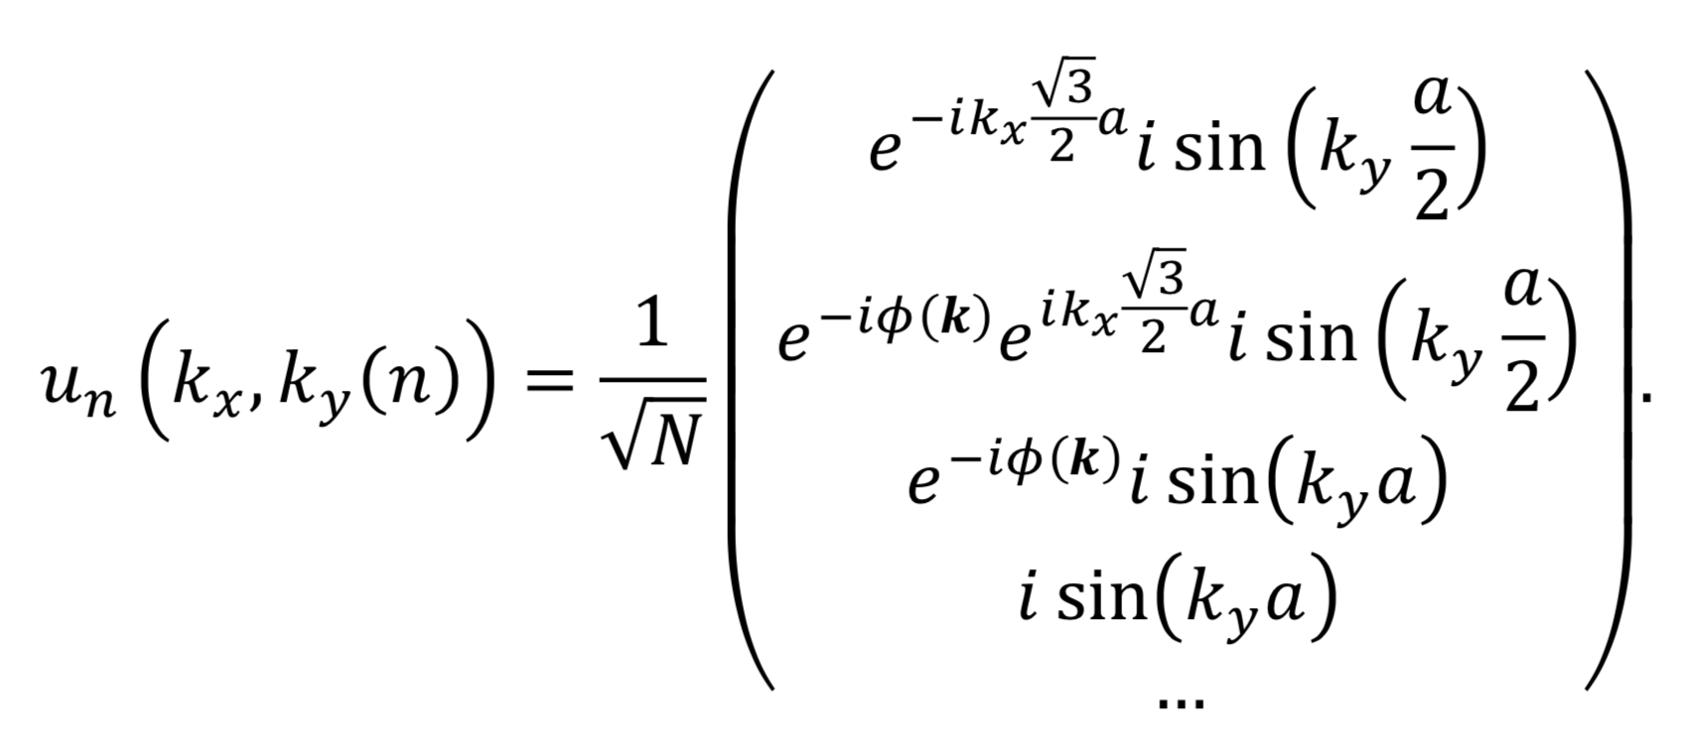
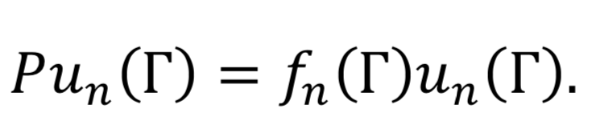
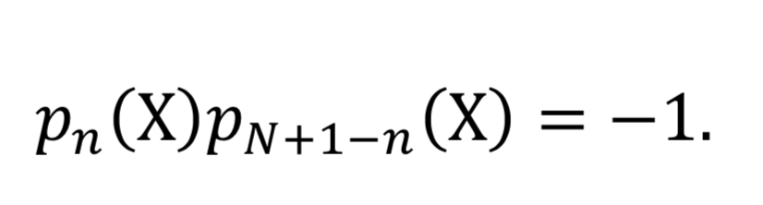
GNR
Construct the WF of GNR as linear combination of (k_{x,}k_{y}) and (k_{x},-k_{y}) states
Wavefunctions at BZ center are eigenfunctions of parity operators
At X point u_{n}(X) and u_{N+1-n}(X) are orthogonal to each other. They form states with opposite parity.

Slide 6
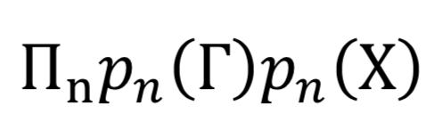
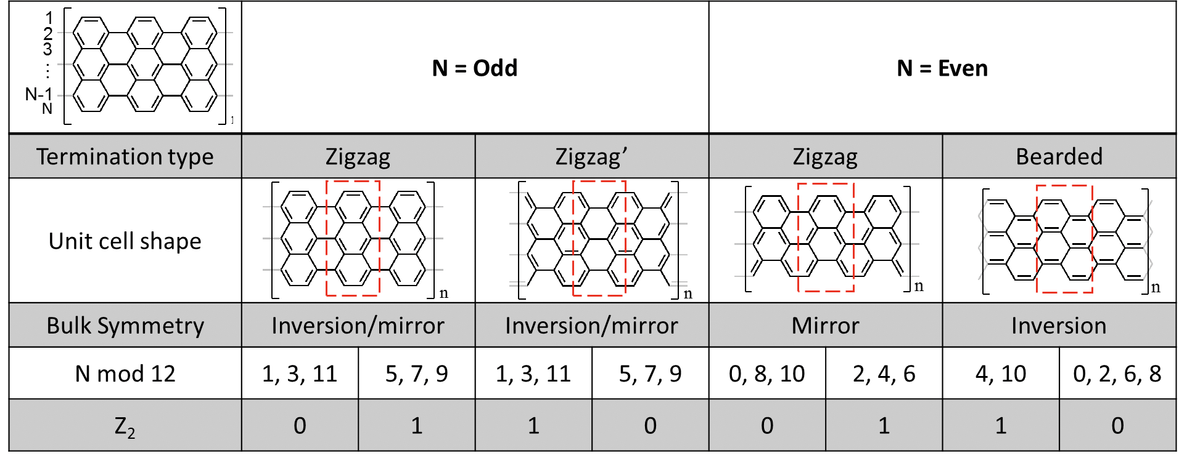
Topological insulators with inversion symmetry
Liang Fu, PRB (2007)
(-1)^{Z2} =
Even and odd number of localized end states for Z=0 and Z2=1 respectively
Confirmed by explicit DFT calculations in Ting Cao, 2017, PRL
Zigzag N=even does not have inversion symmetry!

Slide 7
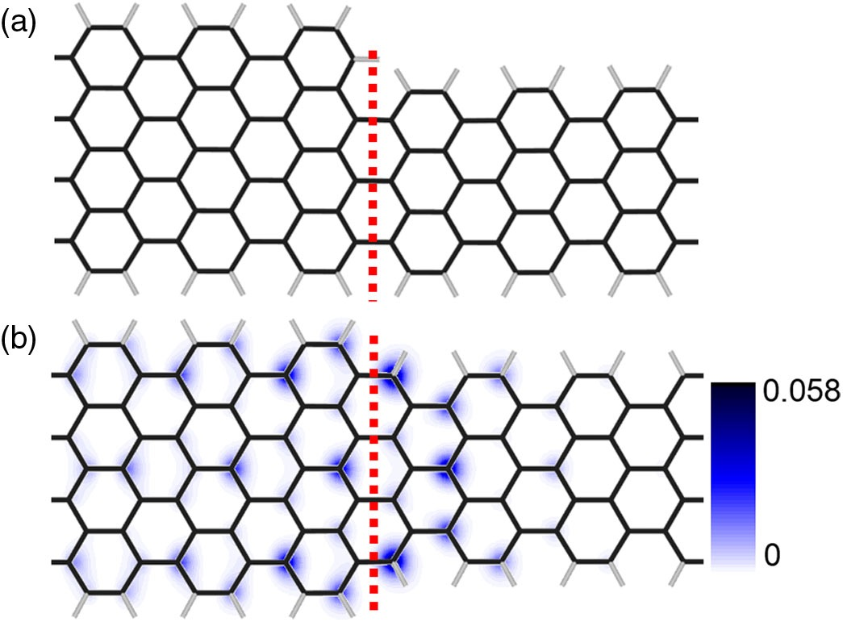
Junction States in GNR
Z2 =1
Z2 =1
Termination of the N=7 GNR changes just by shifting the NR laterally
Z2 becomes 0
Bulk-edge correspondence
N=9
N=7
Z2 =1
Z2 =0

Slide 8
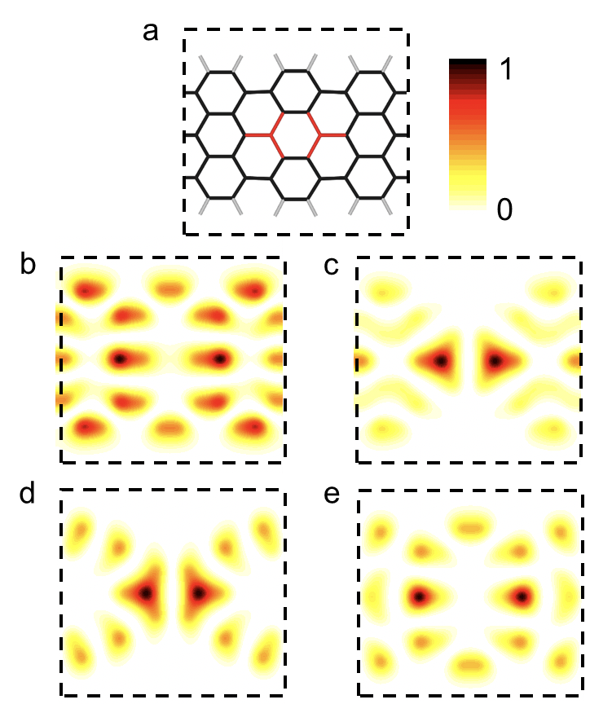
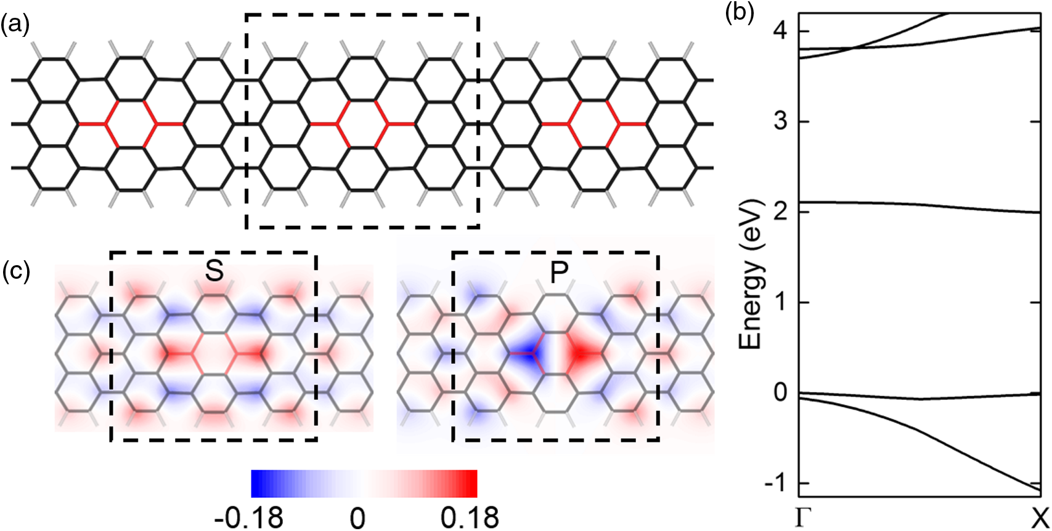
Changing topological class by doping

Slide 9
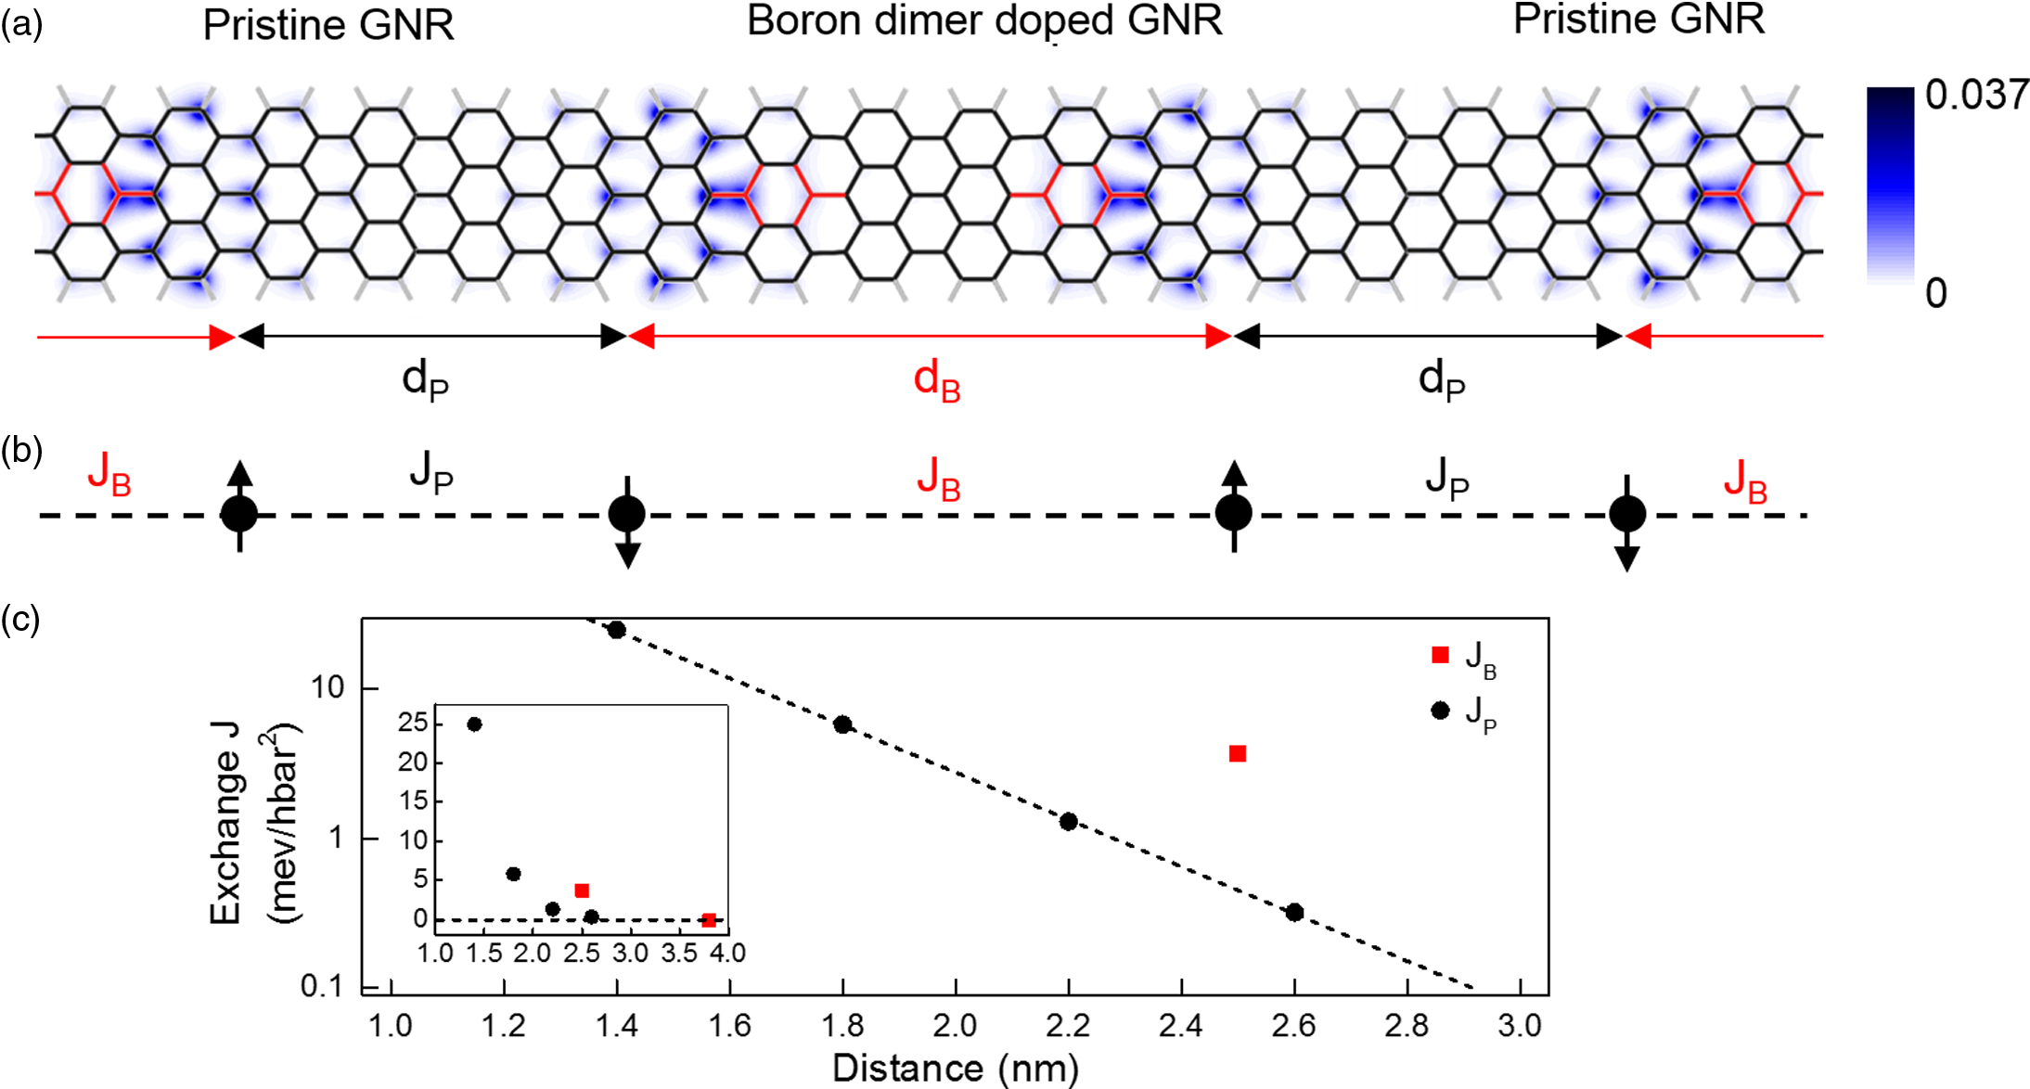
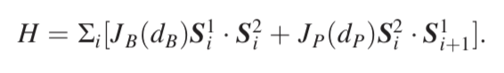
Midgap junction state acts as localized spin centers
1D Heisenberg antiferromagnetic chain
Tunable material platform

Slide 10
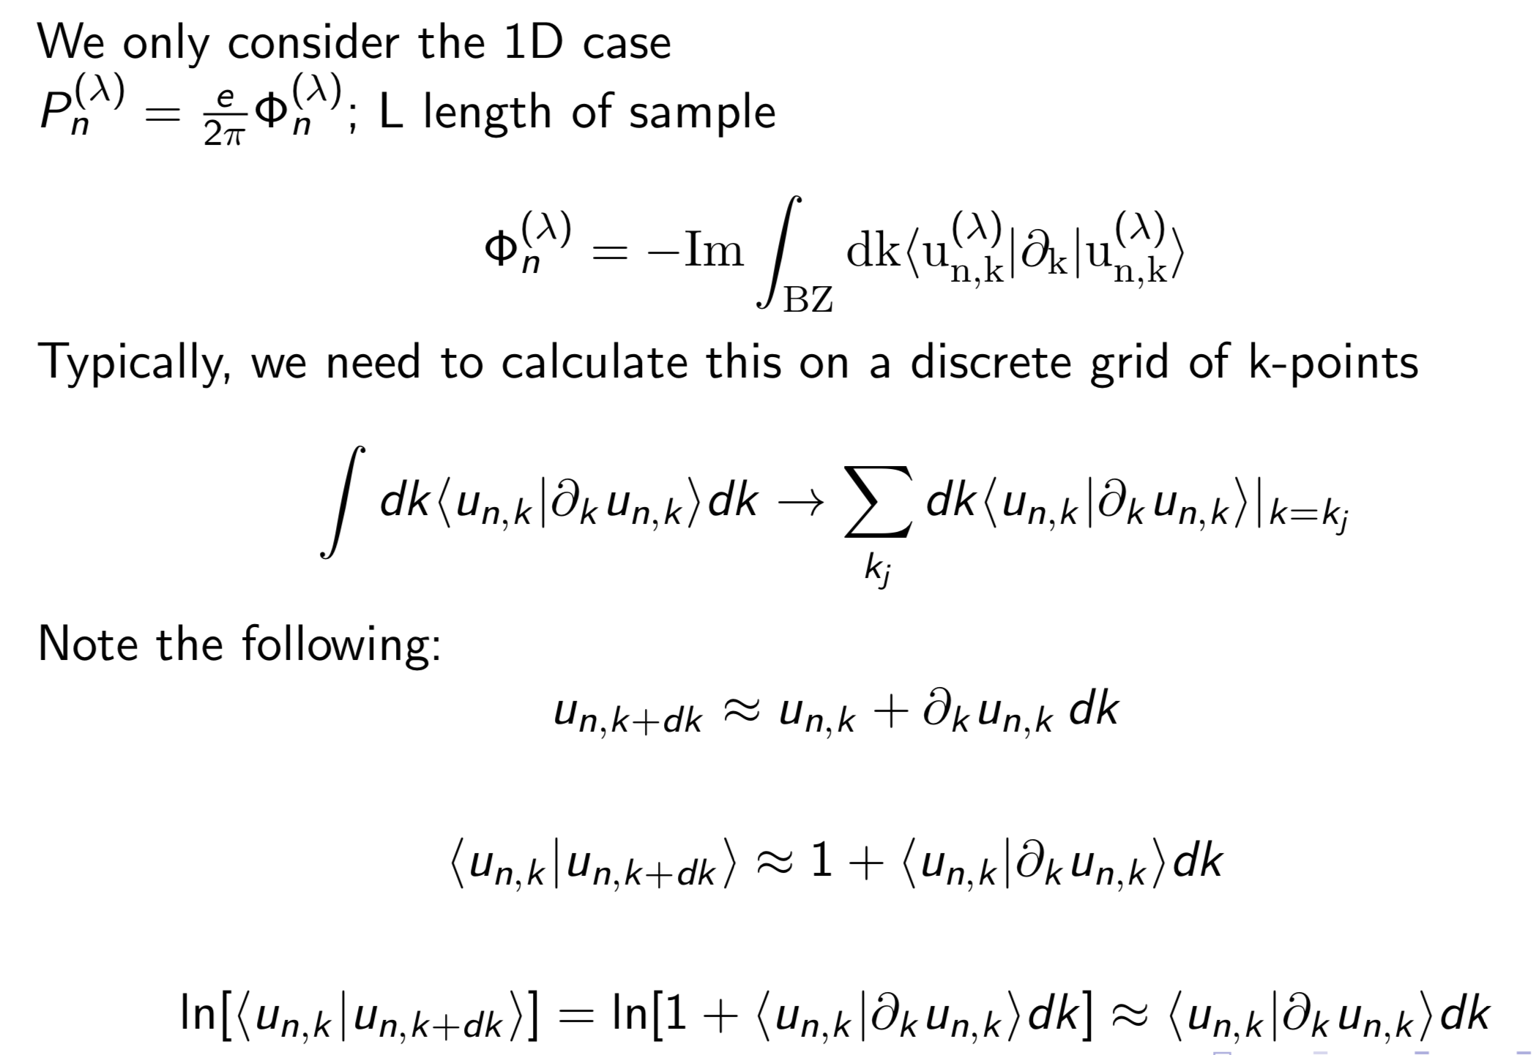
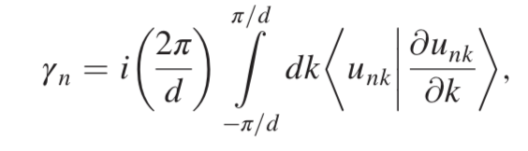
Finite difference to compute Zak phase
Wilson loop

Slide 11
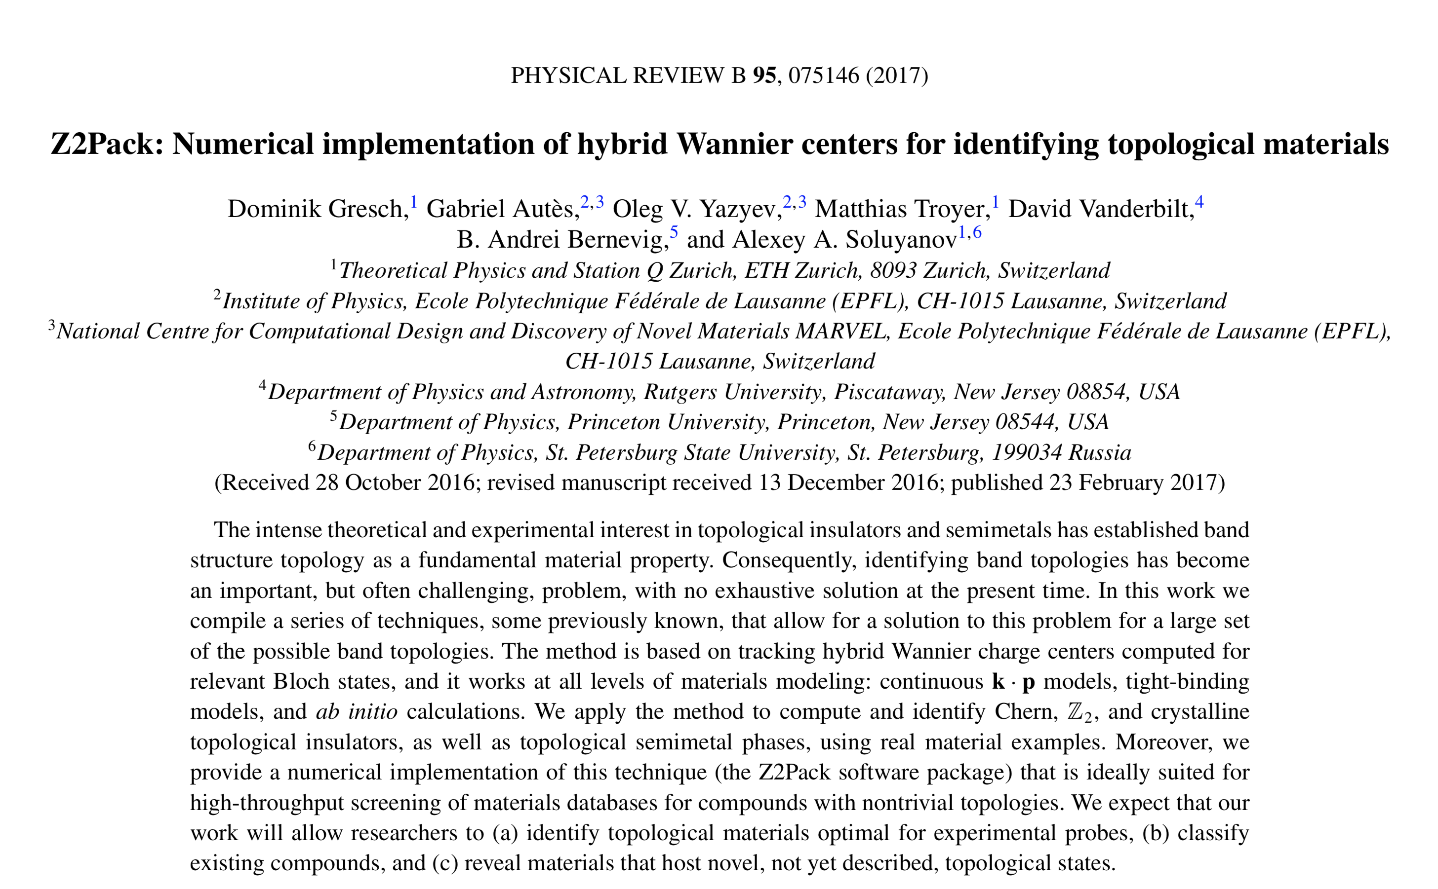
Z2pack
Still experimenting with these methods.

